Slide 1

Battle of the Neighborhoods
Capstone Project
By Andy Chu

Slide 2
Introduction
New York is one U.S. state that has seen a major spoke in COVID-19 cases since the pandemic began
A prominent solution is to migrate to Toronto to avoid potential infection
It is located in another country, Cananda, and is closer to New York than some other U.S. states
However, we must assess what commodities we will lose and gain by moving
(Ex: stores, banks, restaurants, and supermarkets)
This project aims to compare the frequency and distribution of stores between New York and Toronto. This way we have a clear understanding of what we gain and lose by moving.

Slide 3
Data
We will be using location datasets from both New York and Toronto. The links to both datasets are as provided:
NewYork: https://geo.nyu.edu/catalog/nyu_2451_34572
Toronto: https://en.wikipedia.org/wiki/List_of_postal_codes_of_Canada:_M
We will use the Geocoder package to retrieve latitudinal and longitudinal data manually
We will then compare the coordinates from these datasets to the Foursquare API.
Nearby venues will be marked and analyzed side-by-side
Using this data, we will have a better understanding of how the two locations compare.

Slide 4
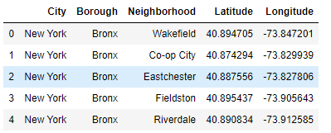
Methodology (New York)
The dataset for New York neighborhoods is available on the NYU website, as well as U.S. government databases
The NY dataset that will be used for this project contains a list of neighborhoods across the NY state, along with latitudinal and longitudinal coordinates.

Slide 5
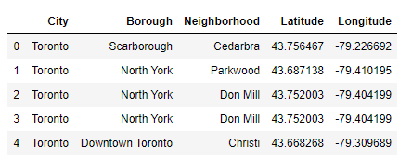
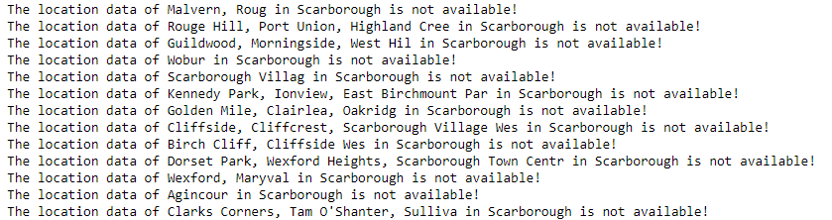
Methodology (Toronto)
The dataset for Toronto neighborhoods was acquired via Wikipedia
Contains a list of postal codes along with the associated borough and neighborhood name
We used the Geocoder package in Python to retrieve the coordinates for each location
Please note that multiple location data were not available
This lack of data may be due to Toronto being out of U.S. jurisdiction

Slide 6
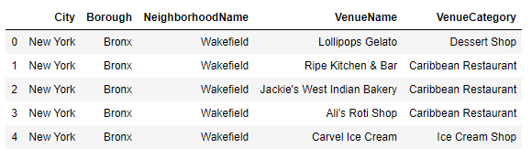
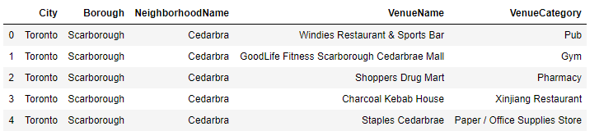
Continue
After organizing the two datasets into tables, we will use the Foursquare API to retrieve nearby venues within each neighborhood
Venues will be classified by name and the type of business they represent

Slide 7
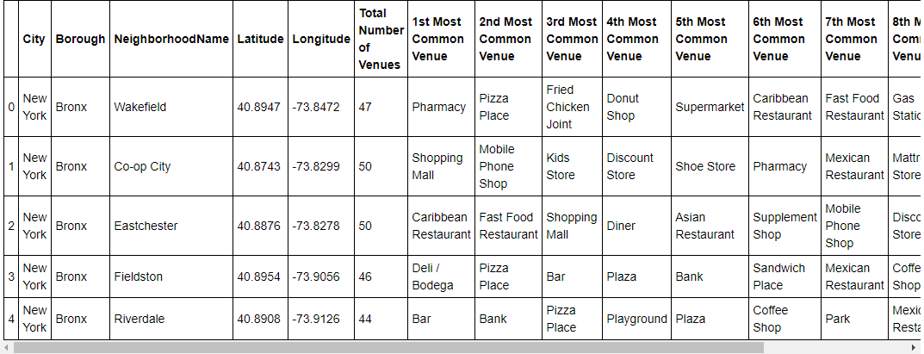
Continue
We combine the Neighborhood table and the Venue table from both locations
Because venues can take on various forms, from restaurants to supermarkets to recreation, we organize the final table by top 10
This creates a fluid dataset that lists each neighborhood along with coordinates and its prominent venues.
Because we use datasets from two major locations, the combined table must be separated into clusters

Slide 8
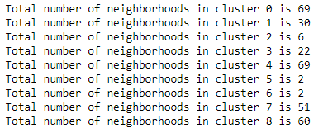
Results
We separate our dataset into 9 different clusters

Slide 9
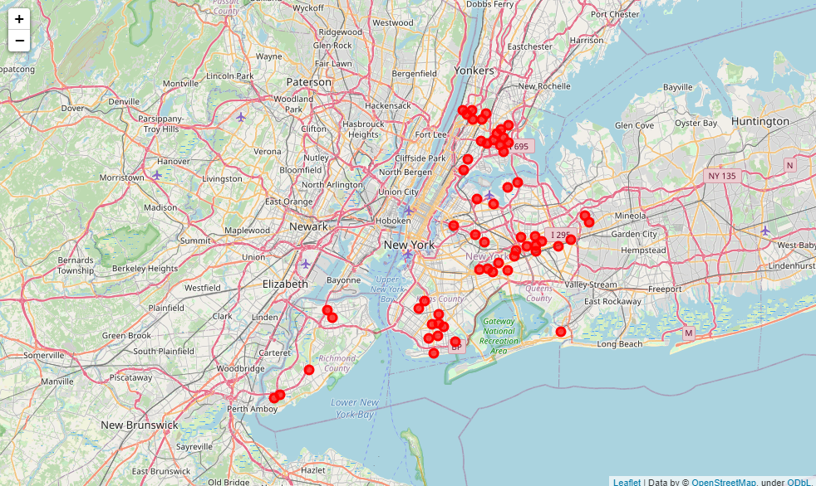
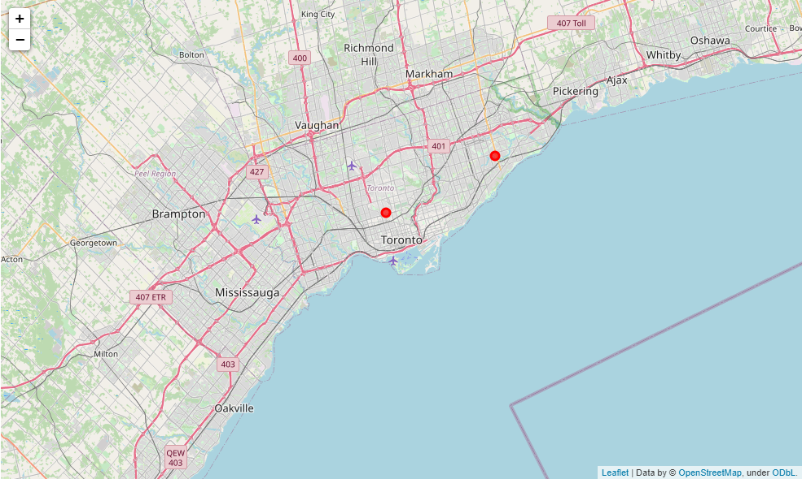
Clustering
We use the top 4 clusters that contain the largest number of neighborhoods
From these cluster maps, we can see that there are significantly more New York neighborhoods than there are Toronto neighborhoods
This is consistent across cluster 0, 4, 7, and 8.
New York
Toronto

Slide 10
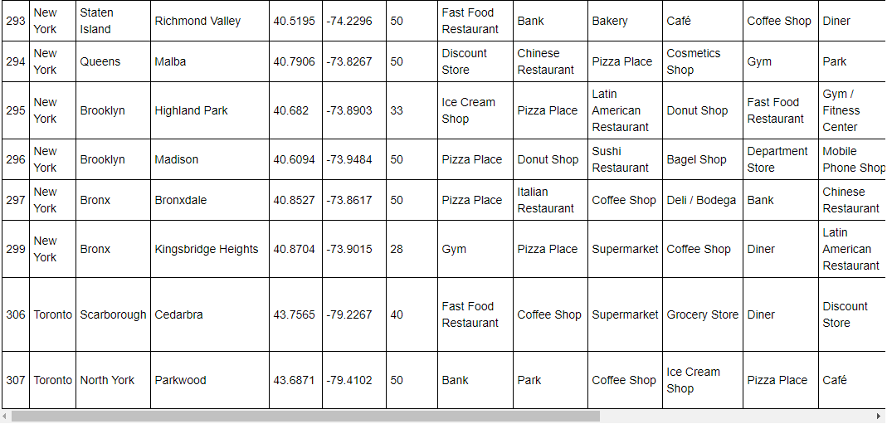
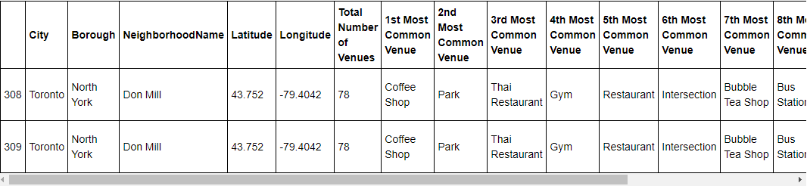
Continue
An in-depth look into the cluster tables will also show what kinds of venues are most common within each neighborhood
For example, in Cluster 8, New York neighborhoods have Pizza restaurants as their #1 venue. On the other hand, Toronto neighborhoods prefer cafes and coffee shops
Moreover, although New York does outnumber Toronto in terms of neighborhoods per cluster, they are equal in terms of venues per neighborhood.
In one outlier, Cluster 6 is evidence that Toronto holds more venues than any single New York neighborhood
As a result, the cluster tables serve as better analysis rather than the visual maps alone.

Slide 11
Discussion
According to the cluster maps, New York significantly outnumbers Toronto in terms of neighborhoods
However, this could be attributed to a lack of data
Because Toronto is located outside the U.S. it may not be possible to retrieve enough information on neighborhood names and their coordinates
In terms of venues per neighborhood, New York and Toronto are on equal standing
The biggest difference would be the types of venues offered
Ex: For majority of New York neighborhoods, the most common venue is Pizza Place. Meanwhile, Toronto neighborhoods is highly populated with Coffee Shops.
If a person were to migrate from New York to Toronto, their options for available neighborhoods may be limited
However, the choice for stores, food, and entertainment are plentiful
Individual tastes may also play a factor, as the types of popular restaurants and stores may differ between locations
Overall, the freedom of choice is still present, which means the individual will not have to sacrifice much if they plan to move.

Slide 12
Conclusion
While New York and Toronto are located within different countries, the city aspects do not seem to change
Both locations offer a wide variety of venues across all available neighborhoods
From supermarkets to banks, everyday commodities stay the same.
During a time of great stress and change, it is good that there are still constants no matter where we go.

Slide 13


